Slide 1
Example for Visual Presentation
Topic: PENN STATE Football
Identify the Chapter or Lesson Here
By K Jensen

Slide 2
PSU Football Dramatic Image
Homecoming 2013 PSU beats Michigan in fourth overtime. This catch was pivotal to that win.
Citation:
B. Chen. “Distraction of the Day: Penn State Beats Michigan” Onward State. May 5, 2014. Accessed July 20, 2017 onwardstate.com/2014/05/05/distraction-of-the-day-penn-state-beats-michigan/#prettyPhoto

Slide 3
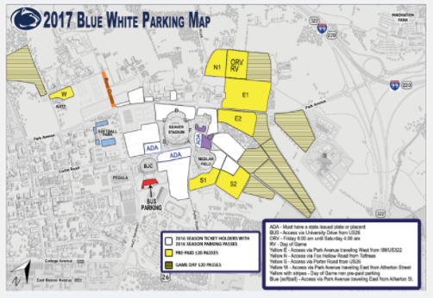
PSU Football Modern Image
PSU Blue White Parking Map
Citation:
Penn State Athletics. “Fans Reminded of Blue – White Game parking changes and details.” PENN STATE News. April 20, 2017. Accessed July 20, 2017
news.psu.edu/story/463819/2017/04/20/athletics/fans-reminded-blue-white-game-parking-changes-and-details

Slide 4
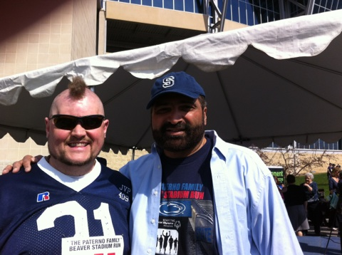
PSU FOOTBALL Legacy & Personally Created Image
Fan (my Husband) with NFL Hall of Famer Franco Harris, former Steeler and Penn State football player.
Citation:
K. Jensen, Personal Photo Collection. Taken at Paterno Family Stadium Run, April 13, 2014.

Slide 5
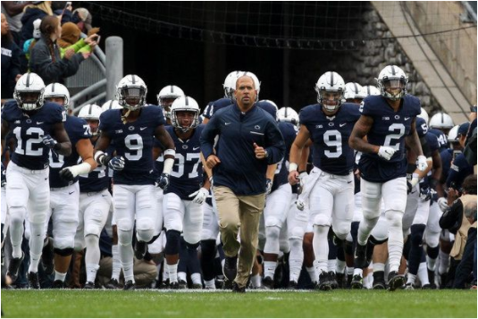
PSU FOOTBALL Classic Image
Coach Franklin leading the team on the field.
Image Citation:
M. O’Haren – USA Today. “Penn State Nittany Lions head coach James Franklin leads his team onto the field prior to the game against the Minnesota Golden Gophers at Beaver Stadium.2016” Found “Maryland vs. Penn State: RECAP, score, stats (10/8/16), College Football Week 6”. NJ.com True Jersey, October 8, 2016. Date Accessed: July 20, 2017 nj.com/sports/nfl/2016/10/maryland_vs_penn_state_live_sc.html

Slide 6
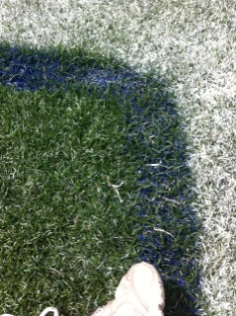
PSU FOOTBALL Challenge Image
Grass on the Field, 9 yard Line
at Beaver Stadium, University Park
Citation:
K. Jensen, Personal Photo Collection. Taken at Paterno Family Stadium Run, April 13, 2014.

Slide 7
Citations
1- Dramatic Image: B. Chen. “Distraction of the Day: Penn State Beats Michigan” Onward State. May 5, 2014. Accessed July 20, 2017 onwardstate.com/2014/05/05/distraction-of-the-day-penn-state-beats-michigan/#prettyPhoto
2 - Modern Image: Penn State Athletics. “Fans Reminded of Blue – White Game parking changes and details.” PENN STATE News. April 20, 2017. Accessed July 20, 2017
news.psu.edu/story/463819/2017/04/20/athletics/fans-reminded-blue-white-game-parking-changes-and-details
3 - Personal Image: K. Jensen, Personal Photo Collection. Taken at Paterno Family Stadium Run, April 13, 2014.
4 - Classic Image: M. O’Haren – USA Today. “Penn State Nittany Lions head coach James Franklin leads his team onto the field prior to the game against the Minnesota Golden Gophers at Beaver Stadium.2016” Found “Maryland vs. Penn State: RECAP, score, stats (10/8/16), College Football Week 6”. NJ.com True Jersey, October 8, 2016. Date Accessed: July 20, 2017 nj.com/sports/nfl/2016/10/maryland_vs_penn_state_live_sc.html
5 - Challenge Image: K. Jensen, Personal Photo Collection. Taken at Paterno Family Stadium Run, April 13, 2014.

